Slide 1
Welcome to PSY 440

Slide 2
AGENDA
Introduction
Required Materials
Course Overview
Behavior Change Paper
Health Information Paper
Day in the Life Project
Timeline
AI Use
Reminders

Slide 3

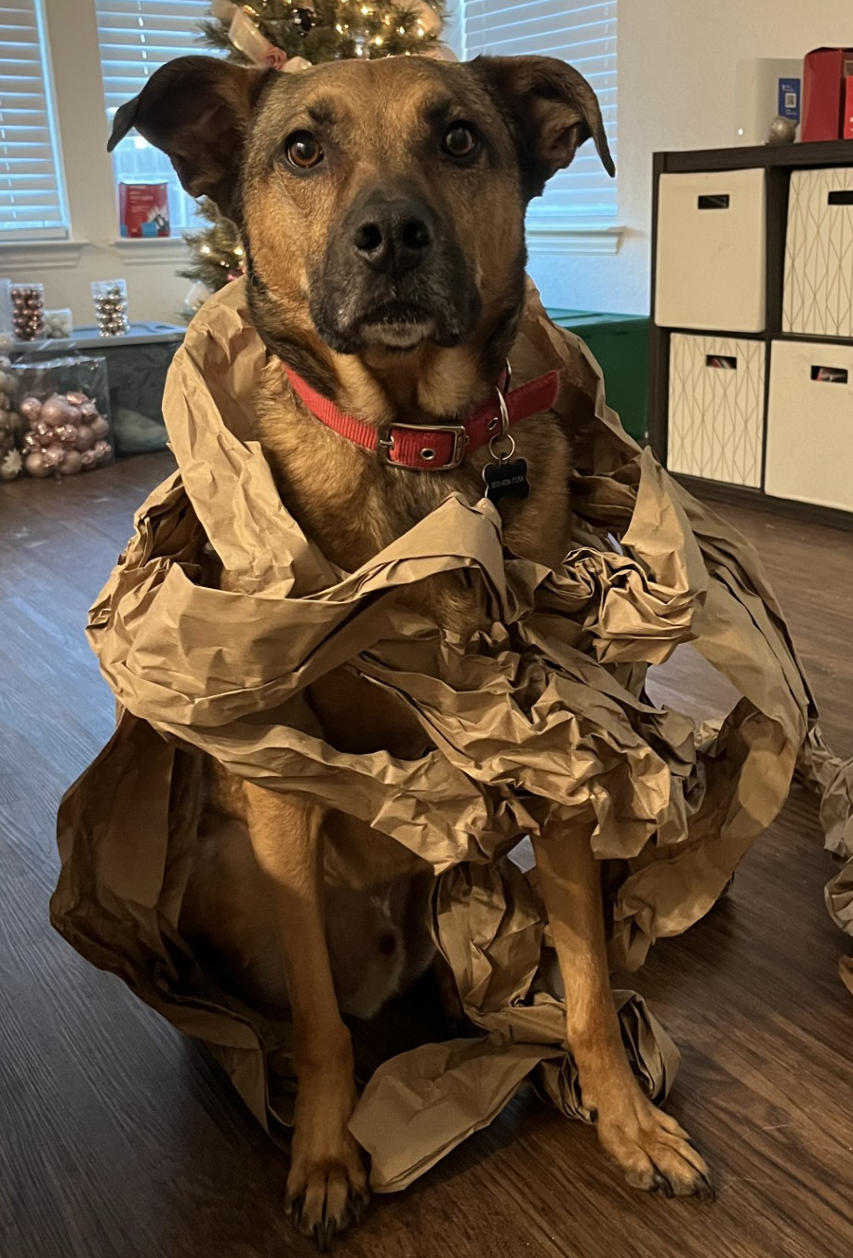
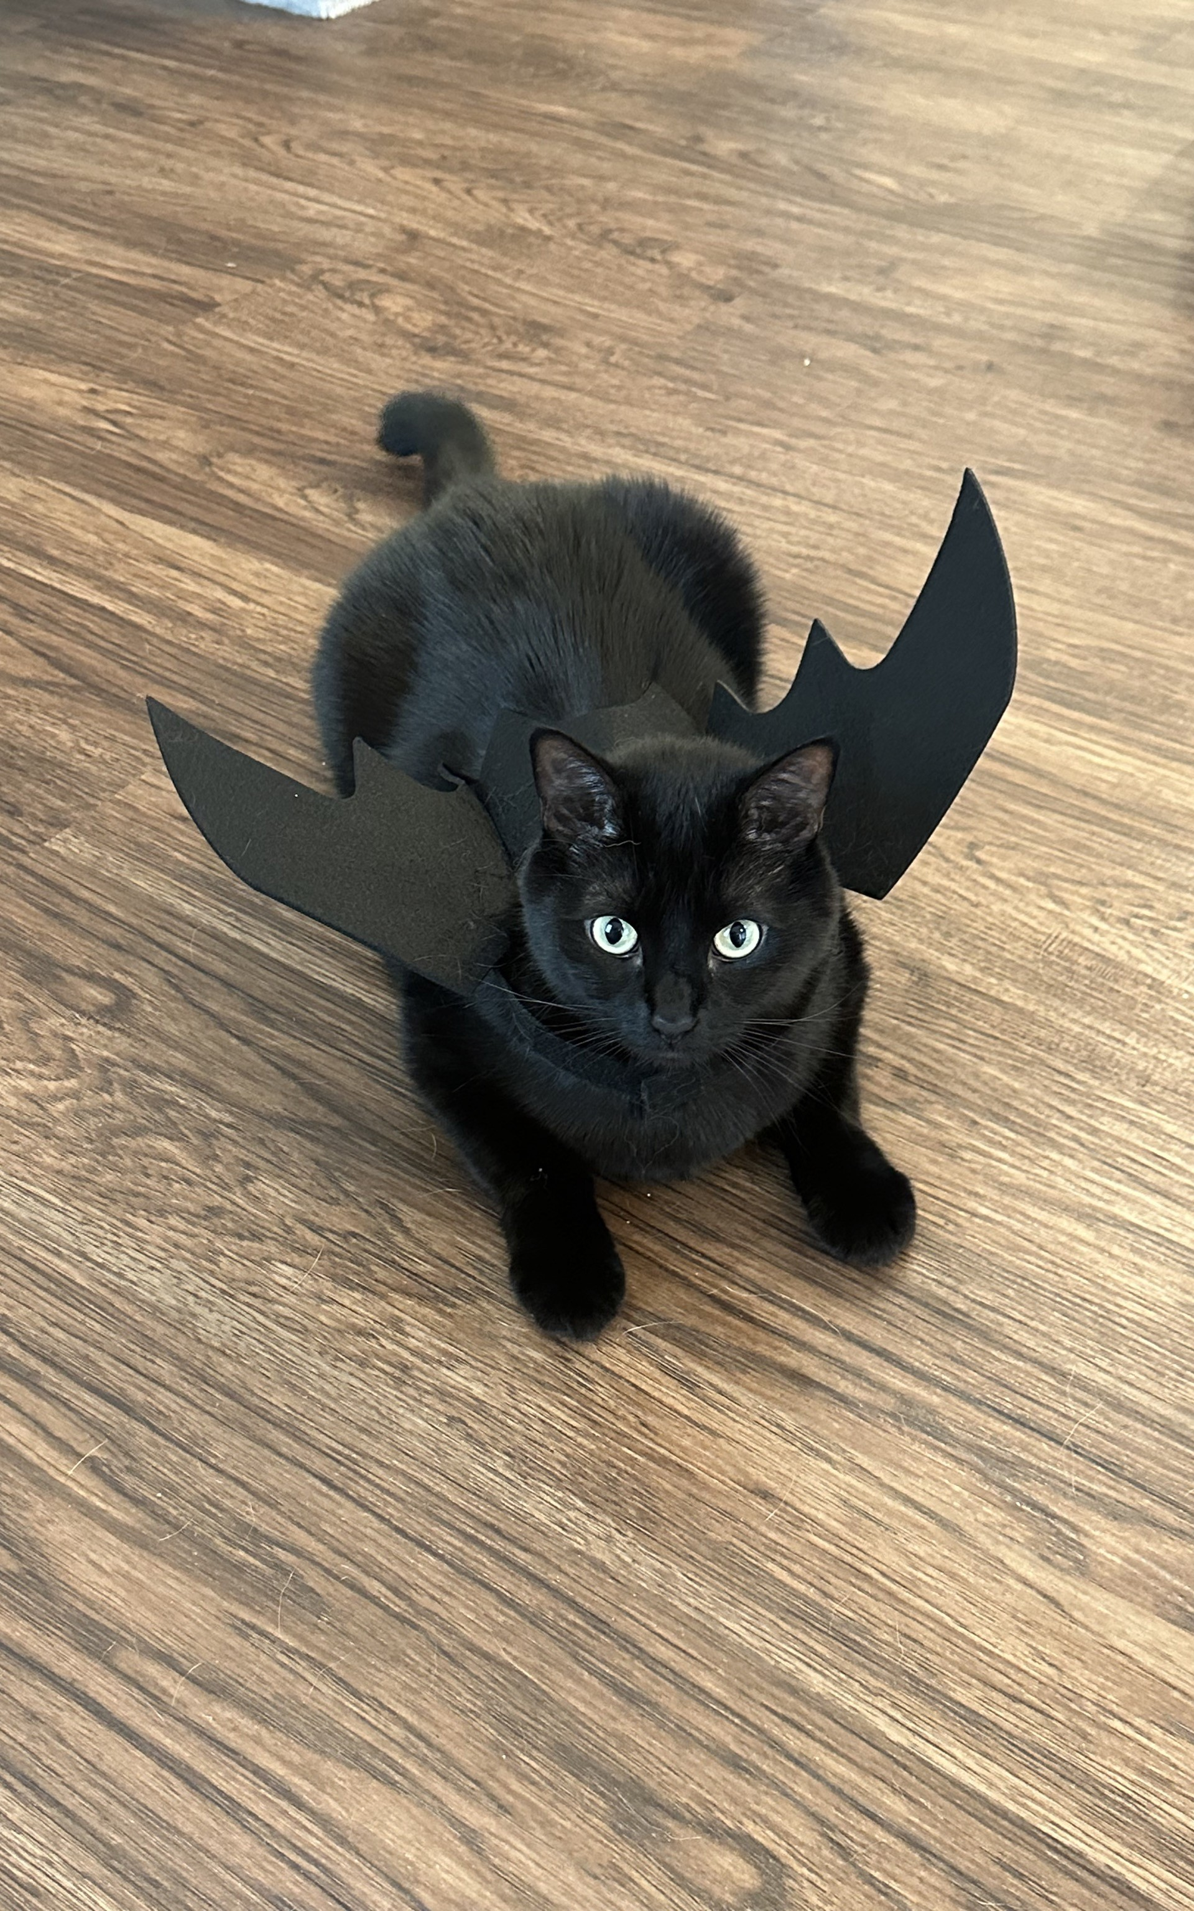

Meet Dr. Scheuler
Hometowns:
Chadron, NE & League City, TX
Education:
B.S. in Psychology from Tarleton State University
M.S. in Applied Psychology from Tarleton State University
Ph.D. in Psychology from University of Texas at San Antonio
Research:
Background: mathematical psychology; health psychology; cognitive psychology
Specialty: Cancer-related cognitive decline

Slide 4
Plans are nothing; planning is everything.
“
”
- Dwight D. Eisenhower

Slide 5
Contacting Me
Office Location
Copeland Hall 320E
Office Hours
MWF 2:30pm – 3:30pm
TH 11am – 12pm
By appointment
Email: scheulerb2@unk.edu
Please use guidelines in syllabus
DO NOT use "messaging" on Canvas – there’s a decent chance I will never see it
Subject: PSY 440 [SUMMARY OF EMAIL HERE]
Hello Dr. Scheuler,
Write your question(s) here, in full sentences and full words (e.g., no abbreviations such as “IDK”). If your question refers to a certain chapter, exam, or assignment, be sure to specify which item you are referring to in your email (e.g., instead of saying “I need help on the book,” you could say “I have a question about a role of the nervous system discussed in Chapter 2”). If you would like to discuss the question in person, please provide times of availability, such as:
Tuesday 4-5pm, Wednesday 8-9am, 11am-12pm, Friday, after 3pm
Thank you, Your Full Name

Slide 6
Required Materials
All material for this course will be provided through Canvas (so you do not need to buy anything). Feel free to open Canvas on your own devices to follow this demonstration.

Slide 7
Course Overview

Slide 8
Class Activities
Rather than calling attendance, every class day will have either a journal question or class activity.
Why do we do these?
Increase retention
Actual application abilities (including outside of class content)
Improve ability to discuss health topics

Slide 9
Note on Class Discussions
Material in this course covers topics such as chronic illness and death. These topics are incredibly important, but can also be extremely difficult, and emotionally taxing. While we dive into these topics, please remember to be mindful and respectful.

Slide 10
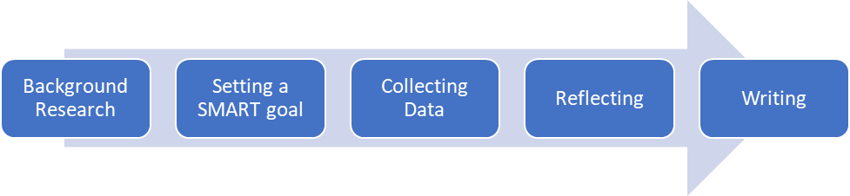
Behavior Change PAPER
Why do we do this?
-Give context for understanding difficulties in interventions
-Practice scientific process in approaching health
-(Hopefully) improve health

Slide 11

Health Information PAPER
Why do we do this?
-Improve scientific literacy
-Understand the complexities of how health information is communicated with the public
-Learn to evaluate sources, separating fact from opinion, and understanding why things are expressed in a specific way
-I can’t, won’t, and shouldn’t tell you all the answers. Instead, I want to help you learn how to find them for yourself.

Slide 12
Day in the Life Project
Health Condition
View of Self
Diet
Physical/ Accessibility
Financial Burden
Career Options
Social Life
Completed in small groups
Semi-randomly assigned topics (e.g., type 1 diabetes, multiple sclerosis, Parkinson’s disease, etc.)
Focus on each area PLUS two separate intersections
Presented during final exam window (May 6th, from 1pm to 3pm)
Grade based on presentation, group evaluation, and personal reflection
Why?
Empathy building
Improve understanding about the complexities of chronic health conditions

Slide 13
Timeline
Week | Dates | Topics | Readings | Important Dates
1 | Jan 12 – 16 | Course Intro; What is Health Psychology | Syllabus; Kaplan, 2009
2 | Jan 19 – 23 | Holiday; Body Systems | Billman, 2020 | 1/19: Holiday
3 | Jan 26 – 30 | Shaping Health Behaviors; BCP Intro | Ogbeiwi, 2021
4 | Feb 2 – 6 | Health Promoting Behaviors; Health Compromising Behaviors | Wilhite et al., 2022 & Odoms-Young et al., 2024; Hammond et al., 2023
5 | Feb 9 – 13 | Health Compromising Behaviors; Exam; Stress | Beckie, 2012 | 2/11: Exam 1
6 | Feb 16 – 20 | Stress | Beckie, 2012; Stubbs et al., 2018
7 | Feb 23 – 27 | Coping & Resilience; BCP Workday; Using Health Services | Penley et al., 2002; Wasserman et al., 2019 | 2/25: BCP due
8 | Mar 2 – 6 | Health Communication: HIP intro | Hong & Oh, 2020
9 | Mar 9 – 13 | Pain; Exam | Dima et al., 2013 | 3/13: Exam 2
 | Mar 16 – 20 | Spring Break |  | (no classes)
10 | Mar 23 – 27 | Chronic Health Disorders; Heart Disorders | Chan et al., 2020; Suls, 2018
11 | Mar 30 – Apr 3 | Immune Disorders; HIP Workday | Alessi & Bennett, 2020 | 4/3: HIP due
12 | Apr 6 – 10 | Cancer; Death & Dying | Stanger & Wahl, 2023; Crunkilton & Rubins, 2009
13 | Apr 13 – 17 | Death & Dying; Exam; Future of Health Psych | Dekker et al., 2023 | 4/15: Exam 3
14 | Apr 20 – 24 | Future of Health Psych; Day in the Life Project Intro
15 | Apr 27 – May 1 | Project Days
16 | May 4 – 8 | DitL Presentations During Final Exam Window |  | 5/3: Screening Deadline; 5/6 @ 1pm: Presentations

Slide 14
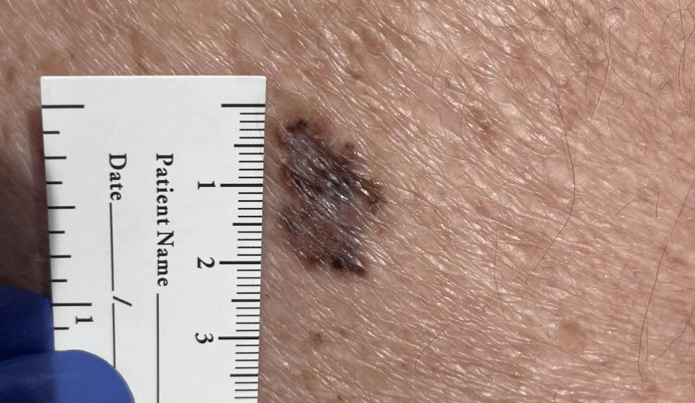
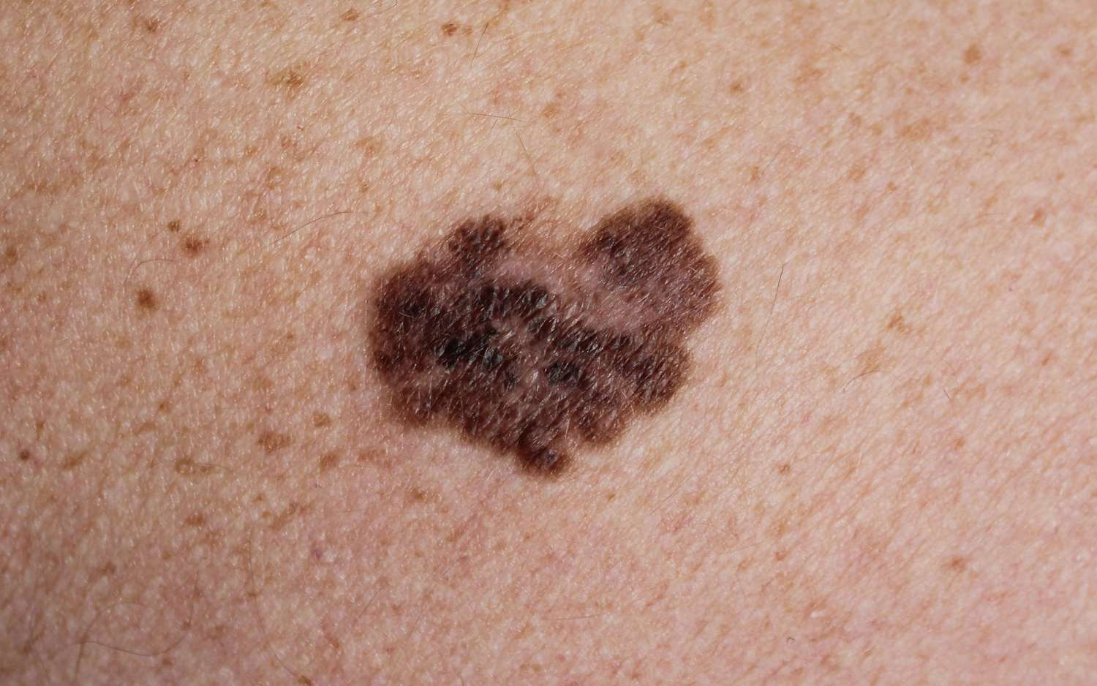
AI Policy
AI is a tool that can work towards a goal. Just like choosing any other tool for a goal, there is a time and place for AI use.
Dr. Scheuler will tell you when an assignment can be completed with AI. If not explicitly said, do NOT use AI.
Why not?
1. What’s the goal of this class?
2. Cognitive offloading vs. cognitive debt
3. Pattern recognition does not equal intelligence

Slide 15
Next time on PSY 440…
In the meantime:
In the Next Class:
Read Kaplan, 2009 (before class on 1/14)
Lecture: What is Health Psychology?

